Slide 1
Project Presentation of CO-OP Project at Industry (Module-2) (22CS421)
On
Experimental Comparison of Disjoint and Overlapping Community Detection Algorithms in Simulated and Real World Networks
Ashima - 2210991398
Ashi Srivastava – 2210991396
Supervised By
Dr. Simarjit Virk
Department of Computer Science and Engineering,
Chitkara University, Punjab

Slide 2
Introduction
What is Community Detection?
• A technique used to identify clusters (groups) of nodes in a network
• Nodes within a community share stronger internal connections than external ones
Networks Where Communities Exist:
– Social Media – friends, followers, interest groups
– Biological Systems – protein interactions, gene regulatory networks
– Communication Systems – call networks, email graphs
– Transportation – road and airline route networks
Why It Matters:
– Recommendation Systems – suggest friends, products, content
– Fraud Detection – identify suspicious clusters of behaviour
– Pattern Recognition – extract structure from complex data
2

Slide 3
Types of Communities
Disjoint Communities:
– Each node belongs to exactly one community
– Assumes clear, non-overlapping group boundaries
– Simpler to compute; less realistic for real-world networks
– Example Algorithm: Louvain
Overlapping Communities:
– A node can belong to multiple communities simultaneously
– Reflects real-world behaviour (a person in multiple social groups)
– More complex to compute; more accurate representation
– Example Algorithms: SLPA, BIGCLAM
Dynamic Communities:
– Communities evolve and change over time
– Used in temporal networks and trend analysis
– Highest computational complexity

Slide 4
Problem Statement
Background:
• Real-world networks are inherently complex, noisy, and multi-layered
• Traditional algorithms fail to capture the true community structure
Key Challenges Identified:
– Overlapping Memberships – nodes belong to multiple communities simultaneously
– High Noise Sensitivity – algorithms degrade when network contains random edges
– Memory & Scalability – overlapping methods often have high memory overhead
– No Universal Best Algorithm – performance varies by network type and noise level
Research Need:
– Systematically compare Louvain, SLPA, and BIGCLAM algorithms
– Evaluate on both synthetic (LFR Benchmark) and real-world datasets
– Identify the best-suited algorithm for different network scenarios

Slide 5
Objectives
Primary Objectives:
• Study and understand community detection techniques for both disjoint and overlapping paradigms
• Implement three algorithms: Louvain, SLPA, and BIGCLAM on benchmark datasets
• Evaluate and compare algorithm performance using standardized metrics
Performance Metrics Used:
– Accuracy – Normalized Mutual Information (NMI)
– Execution Time – time taken to detect communities (seconds)
– Memory Usage – RAM consumed during computation (MB)
Expected Outcome:
– Identify strengths and weaknesses of each algorithm
– Recommend the best algorithm based on network type and noise level
– Provide empirical guidance for practitioners working with real-world networks

Slide 6
Methodology
Step 1: Dataset Selection
– Synthetic: LFR Benchmark graphs with controllable noise parameter (μ)
– Real-world: Zachary's Karate Club (34 nodes) and Dolphins Network (62 nodes)
Step 2: Algorithm Implementation
– Louvain – modularity-based disjoint community detection
– SLPA – Speaker-Listener Propagation for overlapping communities
– BIGCLAM – probabilistic affiliation graph model for overlapping communities
Step 3: Performance Evaluation
– Measure NMI (accuracy), execution time (seconds), and memory usage (MB)
– Run experiments across different noise levels (μ = 0.1 to 0.5)
Step 4: Comparative Analysis
– Cross-algorithm comparison on each dataset and noise condition
– Draw conclusions and formulate algorithm selection recommendations

Slide 7
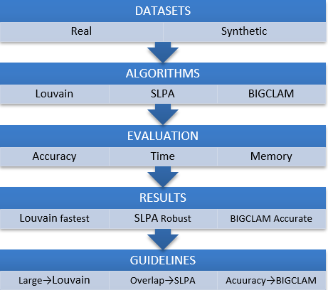

Slide 8
Tools and Technology
Programming Language:
– Python 3.x – widely used for data science and graph processing
Libraries Used:
– NetworkX – graph construction, processing, and visualization
– CDlib – implementation of community detection algorithms (Louvain, SLPA, BIGCLAM)
– Matplotlib – result visualization and plotting
– NumPy / Pandas – data processing and result tabulation
Platform:
– Google Colab – cloud-based Python environment with GPU/CPU support
– Enables reproducible experiments and easy collaboration
Datasets:
– Karate Club Network – 34 nodes, 78 edges (Zachary, 1977)
– Dolphins Network – 62 nodes, 159 edges (Lusseau et al., 2003)
– LFR Benchmark – synthetic graphs with variable noise parameter μ

Slide 9
Algorithm Used
Louvain Algorithm (Disjoint):
– Modularity optimization: greedily merges nodes to maximize Q
– Two-phase: local modularity optimization + graph aggregation
– Time complexity: O(n log n) – fast and scalable to large graphs
– Best suited for: large networks, low-noise conditions
SLPA – Speaker-Listener Propagation Algorithm (Overlapping):
– Nodes propagate community labels iteratively as speakers and listeners
– Threshold τ controls the degree of overlap detection
– Robust to noise; handles overlapping memberships effectively
BIGCLAM – Clique-based Community Affiliation Model (Overlapping):
– Models membership as probabilistic affiliation strength F(u,c)
– Optimized via gradient ascent on a log-likelihood objective
– Highest accuracy for overlapping communities; higher computational cost

Slide 10
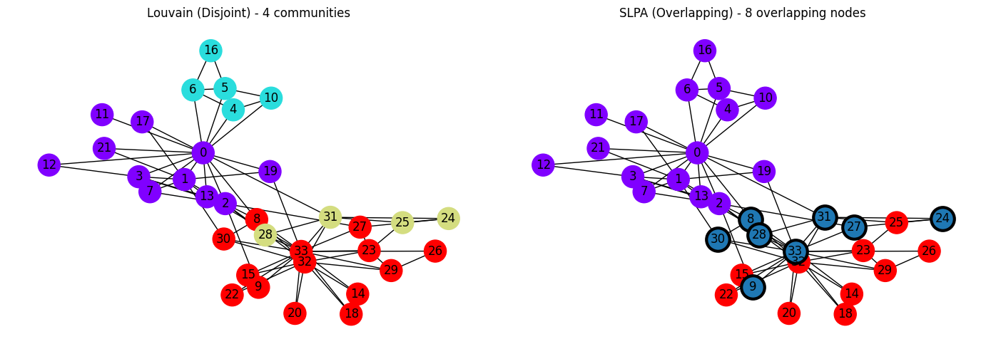
Karate Club network community partitions: Louvain (left) vs. SLPA (right)

Slide 11
Result & Analysis
Louvain Algorithm:
– Achieved highest NMI scores in low-noise (μ ≤ 0.2) networks
– Fastest execution time across all experiments
– Performance degrades significantly when communities overlap
SLPA Algorithm:
– Maintained stable NMI scores across high-noise (μ up to 0.5) conditions
– Successfully detected overlapping community memberships
– Lowest memory consumption among the three algorithms
BIGCLAM Algorithm:
– Achieved the highest overall NMI for overlapping community detection
– Slowest execution time due to iterative gradient ascent optimization
Key Observation:
– No single algorithm is universally best – depends on network type, noise, and resources

Slide 12
Comparison Table
Algorithm | Overlap Detection | Complexity | Main Advantages | Drawbacks
Louvain | No | O(m) | Scalable, Fast | Exclusive Groups only
SLPA | Yes | O(m) | Fast, Flexible | Inconsistent in sparse graphs
BIGCLAM | Yes | O(mk) | Probabilistic, interpretable | Needs k tuning

Slide 13
Conclusion
• This study conducted an experimental comparison of Louvain, SLPA, and BIGCLAM algorithms for community detection on simulated and real-world networks.
• Louvain is fastest and achieves high accuracy in low-noise, disjoint community networks — recommended for large-scale graphs.
• SLPA effectively handles overlapping memberships and performs well under high noise, with the lowest memory footprint.
• BIGCLAM delivers the highest accuracy for overlapping community detection but at a higher computational cost.
• No universal best algorithm exists — the optimal choice depends on network topology, noise level, overlap degree, and resource constraints.
Future Work:
– Explore dynamic community detection for temporal networks
– Test scalability on large-scale real-world datasets (millions of nodes)

Slide 14
Thank You
14

